Slide 1
Tips and Examples
Enabling IT Experience Management –
Communication, Platform Features, Response Rate
HappySignals 2026

Slide 2
Outline
Communication
Platform Features
Response Rates

Slide 3
To ensure the successful launch of your Employee Experience program with the highest possible response rates, it is essential to ensure maximum employee reach via their preferred channels and content types.
Involve others for communication support

Slide 4
Get support for your communication plan and execution
Involve Marketing, Communications or other designated people and departments
Consider creating a message signed off by the CIO or the head of the department spearheading the Employee Experience program
Create a narrative to be the frame and base for all other communication initiatives
Define a communication plan that focuses on regular communication initiatives rather than a one-off email
Consider creating simple and easily consumable content – flyers vs. long emails, videos vs. intranet posts – the more intuitive and approachable the content is, the easier it gets consumed by people and will reach a wider audience.
Ongoing communication creates transparency: Share the aim and purpose, share the first findings and actions that will be taken for improvement, give thanks and appreciation for those who have provided feedback

Slide 5
When communicating about HappySignals to your employees it’s recommended to provide some visuals, videos or other useful materials.
Toolkit for Communication

Slide 6

Basics of HappySignals
These videos and other content provide a good understanding on what HappySignals can do – and also describe how it looks like from the end user perspective.
How HappySignals works (2 min)
HappySignals Surveys to end-users (1 min)
Learn More:
HappySignals Learning Center
Knowledge Base / Support Site
HappySignals on YouTube

Slide 7
Channels of Communication
Some prefer receiving information via classic channels such as email or intranet, whereas others approve of discussion channels such as MS Teams or Slack.
Communication channels you can use:
Email – Message to all employees
ITSM Tool – Auto-reply emails when raising tickets/requests
Intranet article/post
Blog post
Internal communication channels (MS Teams, Slack, VivaEngage, etc.)
Flyers, videos, live screens, posters, coffee machines, elevators, etc.
Message/Video from CIO/CEO

Slide 8

Example Narrative for Introducing Experience Management
Here are a couple of example narratives you can use to communicate to the entire organization.
These are simple suggestions, and you can adjust them to your liking and “tone of voice!”
Help Us to Help You!
We are launching an Employee Experience Program from DD/MM/YYYY onwards, with the aim to better understand how happy and satisfied our employees are with the services they receive across IT. We will use this data to make improvements across IT services and ultimately provide you with a better experience in the future.
What to expect?
We will start collecting employee’s feedback on how you experience and perceive our services, by sending out regular/continuous rating surveys/happiness surveys after each ticket is solved.
Once your problem or request has been resolved, IT support will send you a resolution email including a rating scale from 0-10, where 0 is poor and 10 is awesome. We encourage you to please provide us with a rating and optional feedback to find out how we can improve our services to you. The surveys are short and simple and will take less than 1 minute to complete.
The more feedback you share with us the better visibility we will have on where we can improve moving forward.
We will make sure to be transparent in our findings and share the improvement steps/action points with you along the way!
Our goal is to make our employees happier and more productive in their work and processes!

Slide 9

Example Email or Intranet Article / Blog Post
Subject: Help us to Help you!
Dear valued employee,
We have decided to start continuously measuring your service experience with our IT Service Desk to understand how we can improve employee happiness and productivity and use this data to make improvements to provide you with a better service in the future.
Our tool HappySignals, measures Happiness with a scale of 0 (poor) to 10 (awesome) and asks how much work-time you are losing during each case. You can help us to succeed in improving the service experience each time your case is solved, delivered, or handled as it will trigger a happiness email. Giving a score and providing feedback will only take a few seconds of your time.
Based on your feedback and input we will be able to identify improvement areas quickly. In addition, the person who was serving you can instantly learn from your feedback. So next time you get your IT case resolved, please make sure to rate your service experience by clicking one of the buttons from 0 to 10.
With regards,
Chief Information Officer

Slide 10
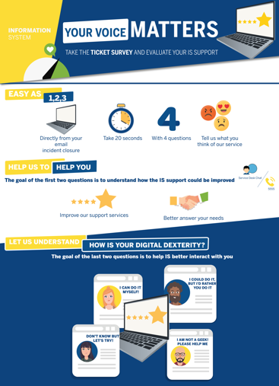
Examples of Communication
Flyers
Once launched, consider providing educational material, tips and guidelines to your employees and organization to better train and educate them.

Slide 11
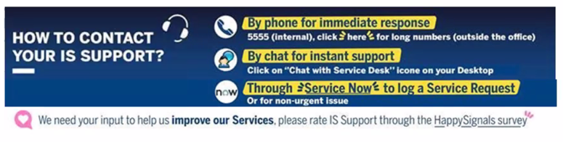
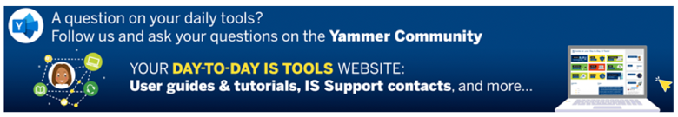
Examples of Communication
Email Signatures

Slide 12
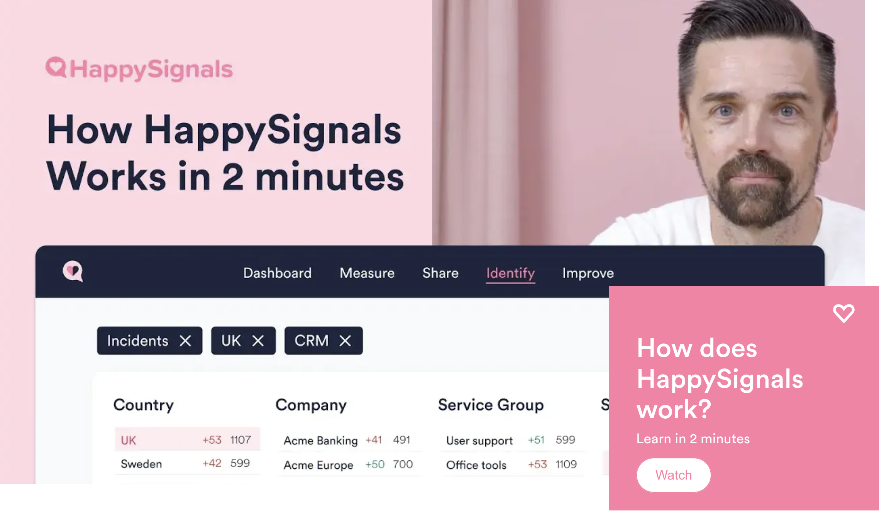
Educational Videos
HappySignals Learning Center contains many short videos and longer webinars about IT Experience Management which you can share.

Slide 13
HappySignals Platform has some features that enable direct communication and increase feedback motivation with the employees.
Platform Features

Slide 14
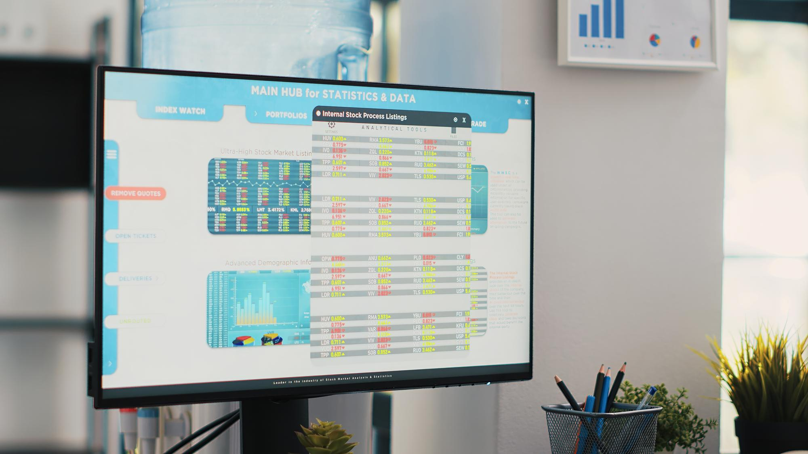
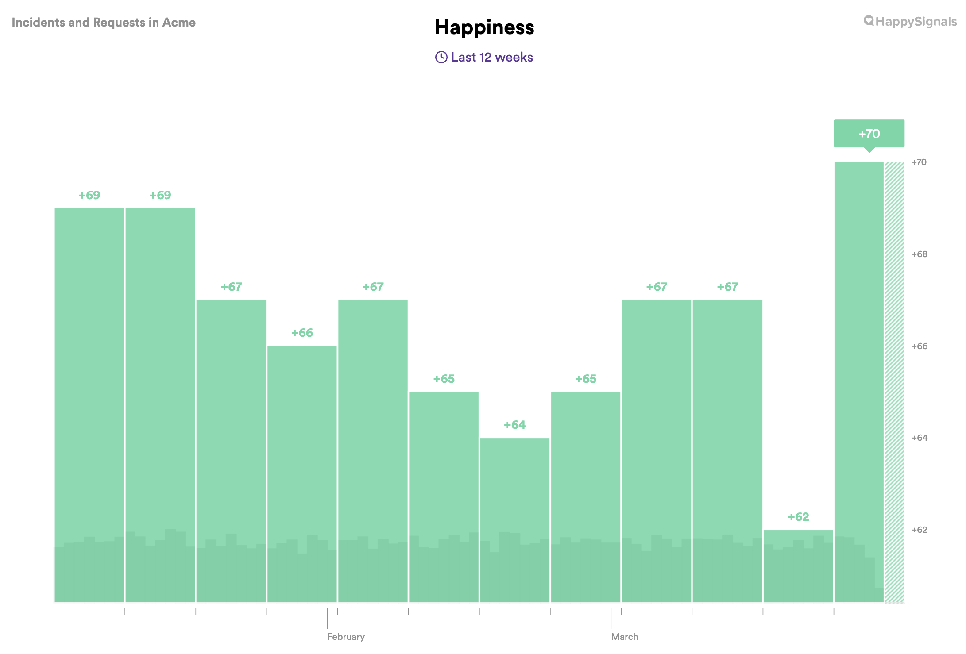
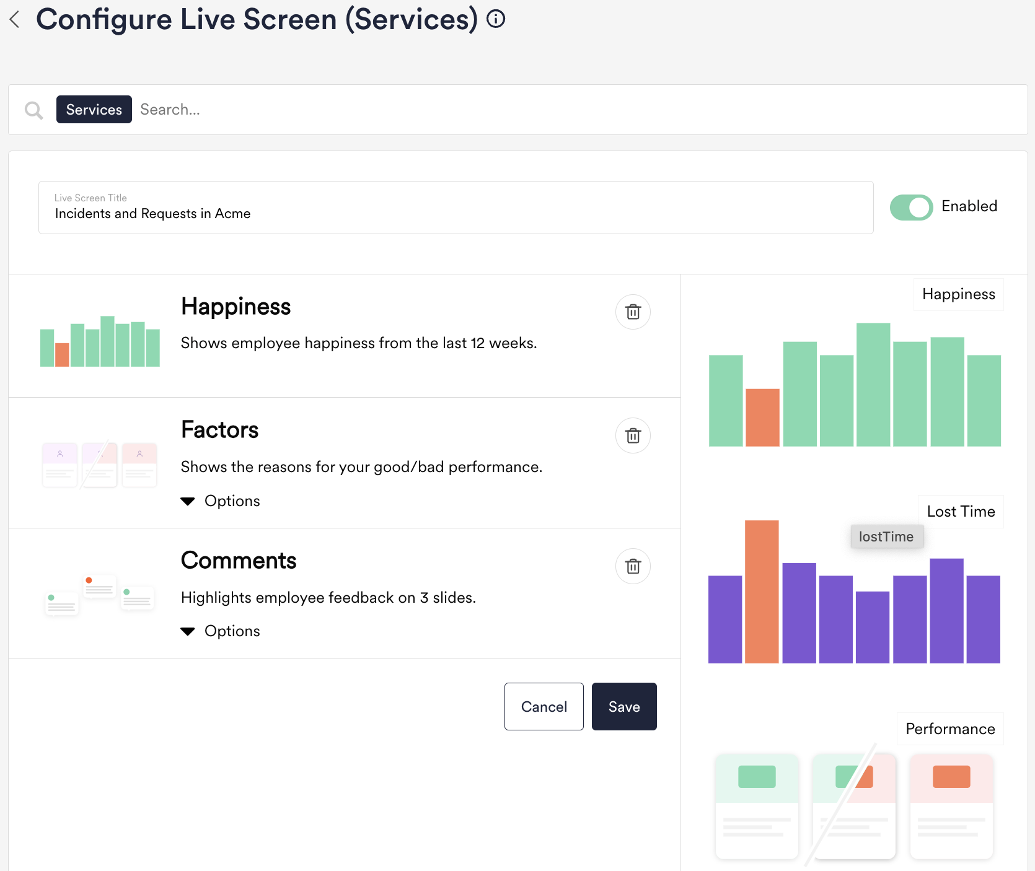
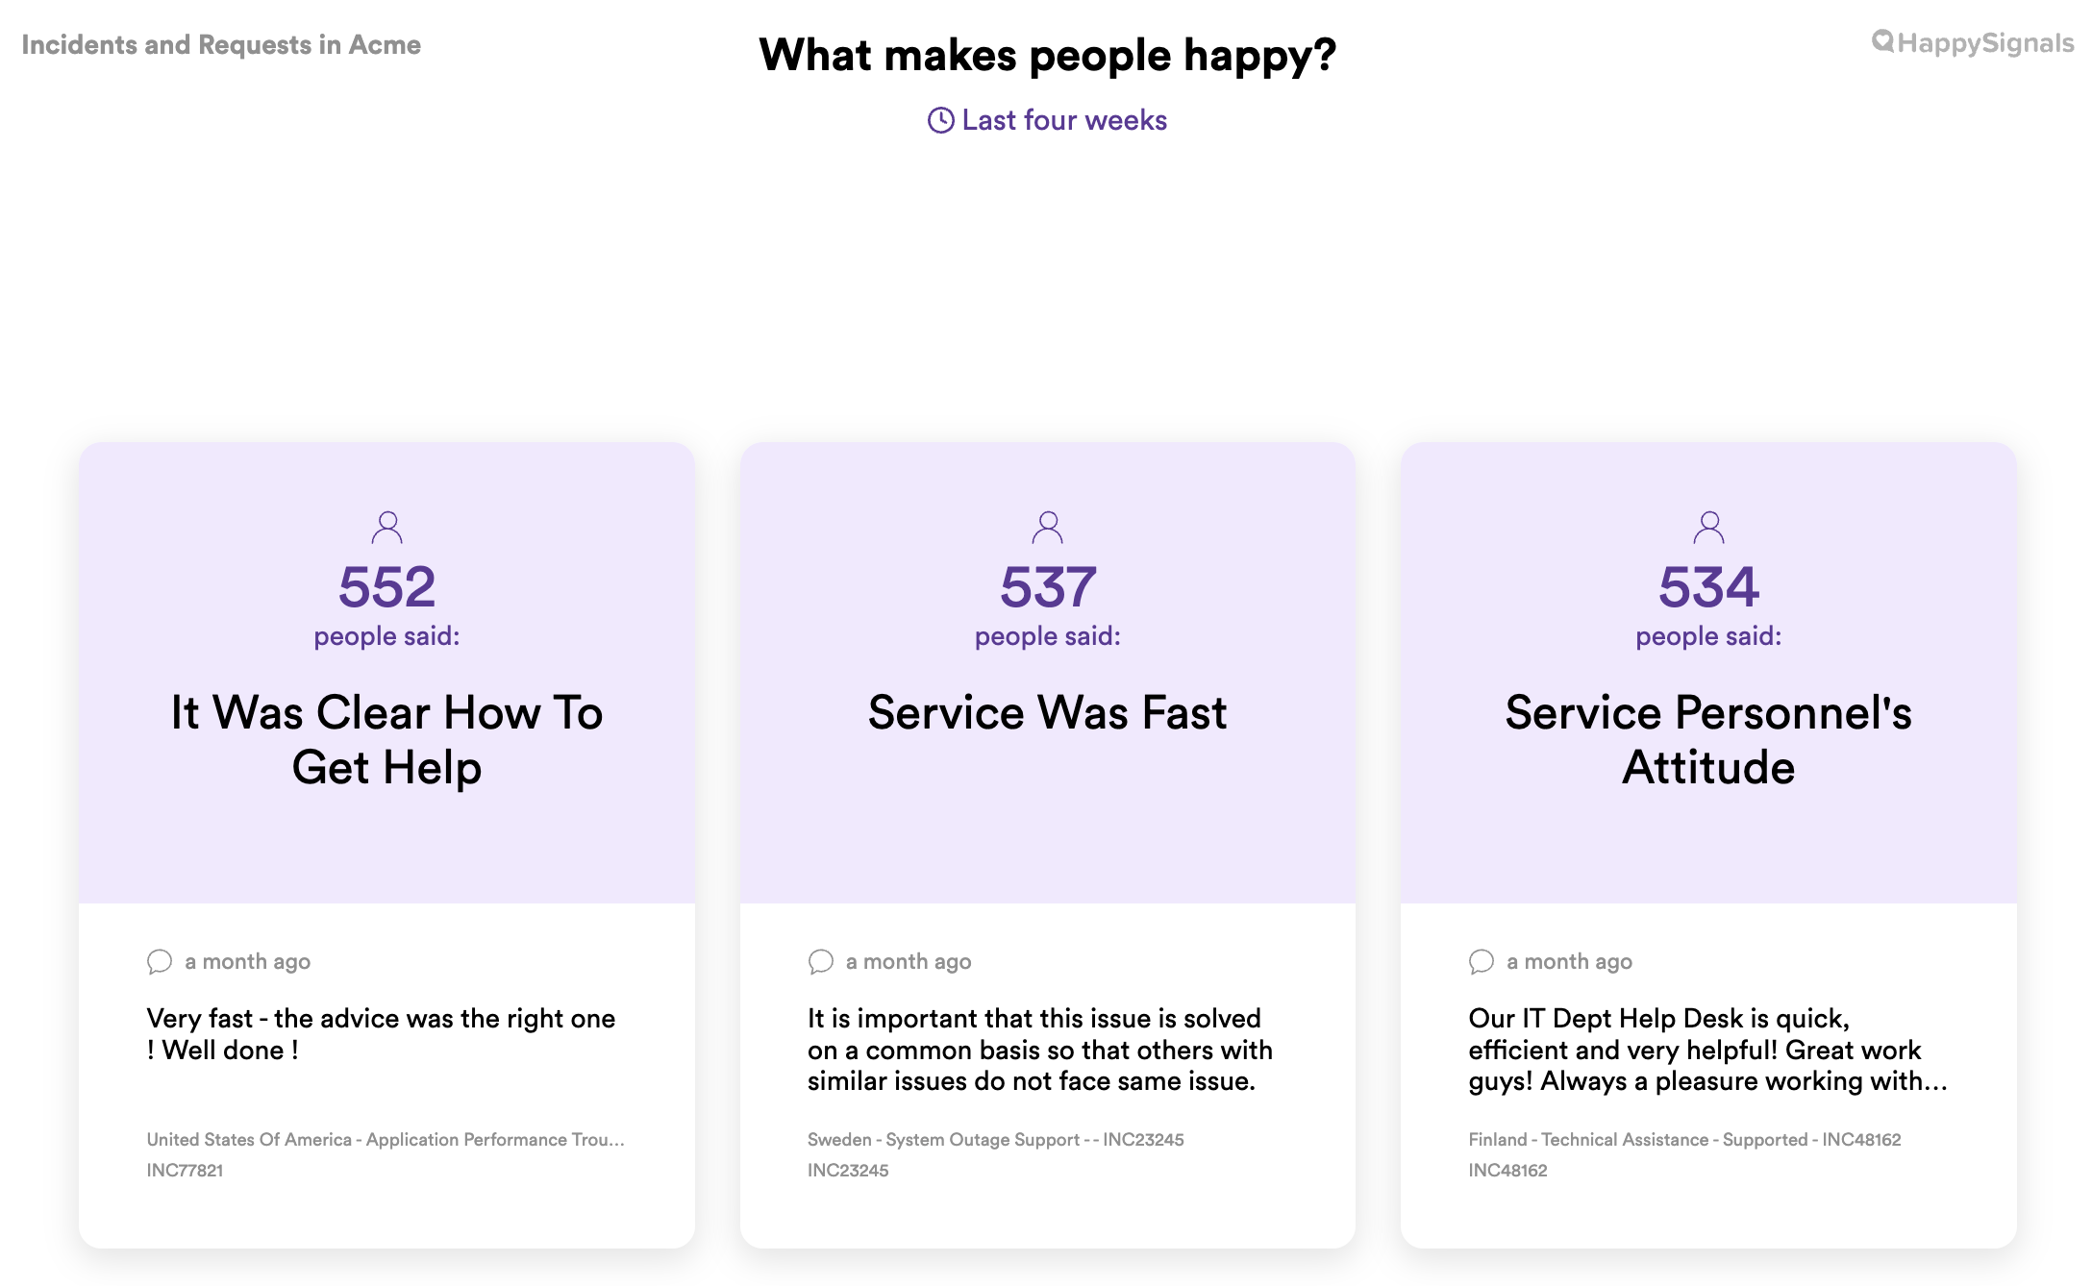
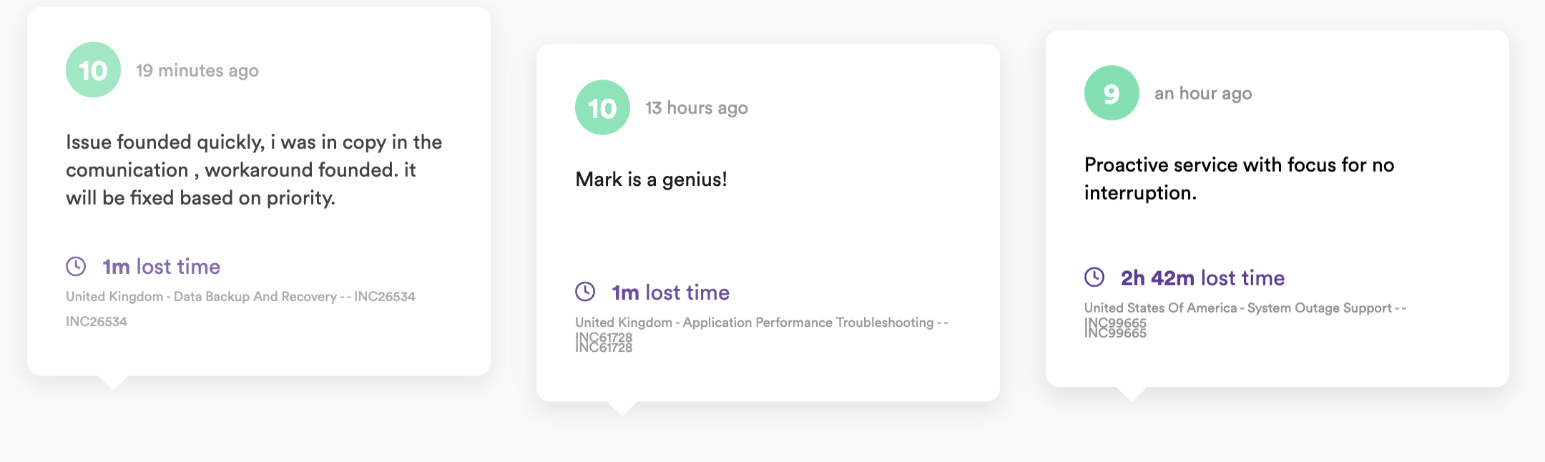
Live Screens at the Office
Self-service configuration
https://support.happysignals.com/help/edit-livescreen

Slide 15
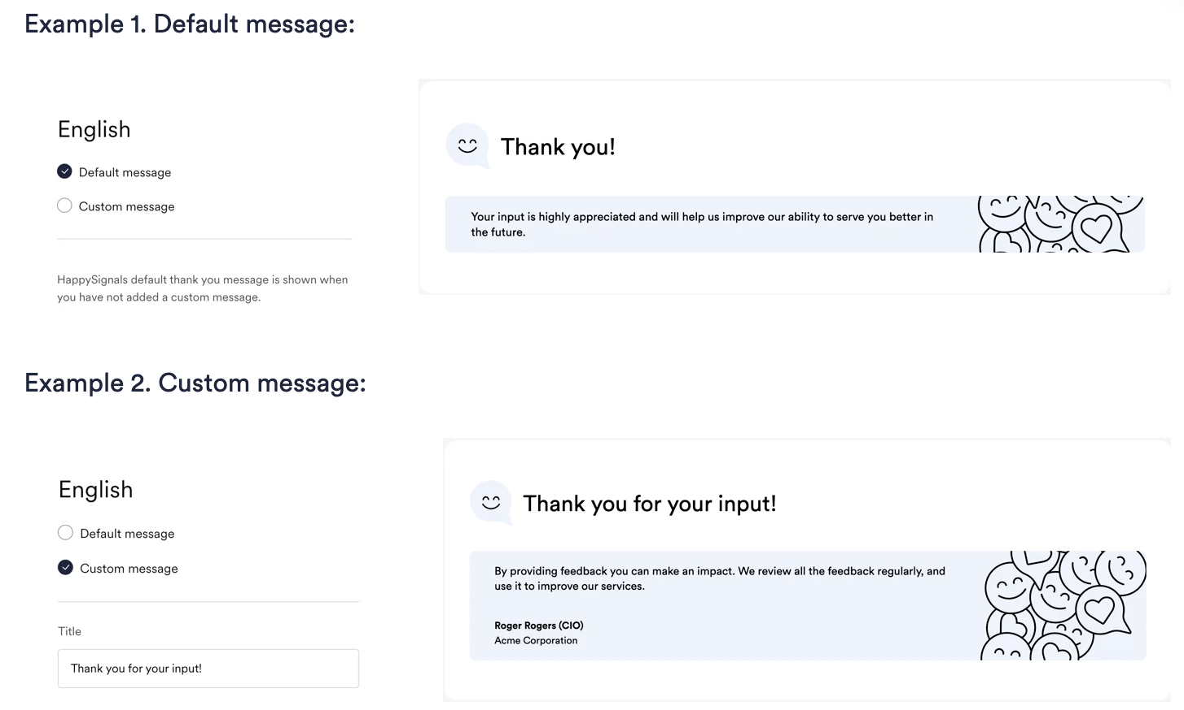
Thank You Message
Easily configure a personal message to display after the user has submitted the feedback.
https://support.happysignals.com/help/custom-thank-you-pages

Slide 16
Our experience shows that just a few minor adjustments to your resolution email templates can remarkably increase your response rates.
Resolution Emails

Slide 17
Example Narrative for Introducing Experience Management
These tips and suggestions are meant to be food for thought.
Adding logos or images to your email is a nice touch to your brand visibility; however, keep in mind that the positioning of the logo or image should not be the center point of the email. In some cases, the logo pushes the content and rating scale down on the screen. As a result, employees don't see the rating scale and don't take part in the rating, and rather ignore the resolution email.
Make sure when adding images that the rating scale is standing out on the first view when opening email on laptops and phones.
Incident & Request numbers / Subject line:
From our experience, end-users feel immediately discouraged when receiving emails with a long incident or request number (eg. INC543057699834). They might simply delete or archive the email immediately.
Rephrasing your subject line to a more actionable wording leads end-users to think they need to complete an action in order for their incident to be solved and request completed! Removing the numbers and making it a little more personal, helps to make the email more receptive and approachable!
Consider changing the subject line to "Close your case by rating your service experience". Of course, we understand that this is not always possible.

Slide 18
Example Narrative for Introducing Experience Management
You are of course free to use your own words and style.
Incident & Request numbers / Subject line:
From our experience, end-users feel immediately discouraged when receiving emails with a long incident or request number (eg. INC543057699834). They might simply delete or archive the email immediately.
Rephrasing your subject line to a more actionable wording leads end-users to think they need to complete an action in order for their incident to be solved and request completed! Removing the numbers and making it a little more personal, helps to make the email more receptive and approachable!
Consider changing the subject line to "Close your case by rating your service experience". Of course, we understand that this is not always possible.

Slide 19
Example Narrative for Introducing Experience Management
Paying attention to detail will be worthwhile.
Greeting and tone of voice:
We suggest that the notification should feel personal for the recipient. You should try using a language that is familiar to the end-user by avoiding ITSM and ITIL terminology.
It should look and feel like it was written by a person, not generated by an automatic system.
Issue description:
Most of the times employees don’t really care about the issue description. They just want to know on a high level if it has been solved. In simple terms, just tell what has been done. Try to avoid long text.
Signature:
Make it personal (if you can). People should sign with their names so that users feel a person had taken care of their case, not a bot or machine. Of course, we understand that this is not always possible or even an option but great if you can!

Slide 20


Email Template: Incidents
Subject: Please accept the resolution to your case by rating your experience: Description (rather number)
Dear NAME,
Your incident “Text of Incident” has been resolved with the following notes:
Text (short and simple; NOT the issue description!)
To close your ticket we kindly ask you to rate your service experience, where 0 is poor and 10 is awesome. OR
Please accept the resolution by rating your service experience, where 0 is poor and 10 is awesome.* OR
Rate our service, where 0 is poor and 10 is awesome!* OR
Rate your service experience, where 0 is poor and 10 is awesome!*
If your issue was not resolved, please click here to reopen the ticket! OR
Should you feel your request was not resolved you can reply to this email within 48 hours. OR
Should you feel your request was not resolved you can reopen the request HERE.
Kind regards,
[First Name] [Last Name]
Service Desk

Slide 21

Email Template: Requests
Subject: Close your request by rating your service experience!
Dear NAME,
Your incident “Text of Request” has been resolved with the following notes:
Text (short and simple; NOT the issue description!)
Please close your request by rating your / our service experience! OR
Please accept the completion of your request by rating your (service) experience, where 0 is poor and 10 is awesome. OR
Rate our service, where 0 is poor and 10 is awesome!
Kind regards,
[First Name] [Last Name]
Service Desk

Slide 22
It takes some effort but it’s definitely worth to focus on improving response rates and response quality.
Response Rates

Slide 23
Response Quality vs. Response Rates
High volumes / response rates are great
Good for confidence (reach and trends) but…
Without quality are not always useful
Gives context and reasons
Reveals pain points and successes
Drives actionable improvement
Quantity
Quality
Quantity shows reach. Quality drives change!

Slide 24
Improve Response Rates
  “…the number one driver of survey fatigue was the perception that the organization wouldn’t act on the results. This was often informed by past experiences, where employees had not seen any communications or action as a result of previous surveys” McKinsey & Company (report)
1. Close the feedback loop
2. Strengthen communication and
leadership engagement
3. Optimize survey design and delivery
Take visible action on feedback and communicate outcomes clearly to employees.
Use HappySignals LiveScreens to showcase real-time feedback and improvements.
Managers and leaders should regularly inform teams about key changes made as a result of feedback.
Respond to feedback through follow-ups, call-backs or group discussions (where permitted and appropriate).
Leverage Corporate Communications to promote survey participation and share results.
Secure senior leadership support to endorse the importance of feedback and encourage participation.
Empower team leaders and influential employees to promote survey completion within their teams.
Include feedback response insights in company-wide communications from senior leaders.
Stop sending feedback requests where not necessary—focus on relevant and targeted audiences.
Review and refine the feedback request email for clarity, tone and relevance.
Ensure the sender name and email display name are recognizable and trustworthy.
Personalize the message: address the employee directly and explain anonymity (if applicable).
Make the survey visually appealing and simple, highlighting how little time it takes and how feedback is used.
Use local language to ensure accessibility and inclusivity.
4. Tactics for Incident/Request
Surveys
5. Engage
6. Improve survey accessibility and visibility
Allow ticket reopen functionality near the top of the feedback email to increase engagement.
Ensure Service Desk agents remind users to provide feedback, with evidence logged in the ITSM tool - this should be distinct from automated resolution notifications.
Identify and work with non-responders (where permitted) to understand barriers and encourage participation.
Conduct focus groups or individual follow-ups with detractors (where permitted) to explore concerns and improve future experiences.
Use Microsoft Teams to deliver surveys where possible.
Display open surveys on the service portal to increase visibility and ease of access.
Share response rates and feedback quality metrics (e.g., free text, support profiles, lost time) with stakeholders to drive accountability.
Send a personalized thank-you message after survey submission to reinforce appreciation.

Slide 25
Improve Response Rates
Category | Activity | Complete | Comments
Close the Feedback Loop | Take visible action on feedback
 | Use HappySignals Live Screens
 | Managers and leaders regularly inform teams of improvements made
 | Respond to feedback through follow-ups
Ticket Responses | Allow ticket reopen functionality
 | Service Desk agents remind users to provide feedback
Strengthen communication & leadership engagement | Leverage Corporate Communications
 | Secure senior leadership support on importance of feedback and participation
 | Empower team leaders and influential employees
 | Include feedback response insights in company-wide communications
Optimize survey design & delivery | Stop sending feedback requests where not necessary
 | Review and refine the feedback request email
 | Personalize the message
 | Sender name and email display name are recognizable
 | Make the survey visually appealing and simple
 | Review and adjust frequency (Proactive surveys only)
 | Use local language
Engage | Identify and work with non-responders
 | Conduct focus groups or individual follow-ups with detractors
Improve Survey Accessibility & Visibility | Use Microsoft Teams delivery
 | Display open surveys on the service portal
 | Share response rates and feedback quality metrics
 | Send a personalized thank-you message

Slide 26
Plan to increase response rates…
It takes effort, but it’s worth it!
Survey Design & Delivery
Share
Do!
Simple and fast to digest
Visually appealing
Appropriate recipients
Email sender address
Sent in local language
Sent via MS Teams
Delivery time of day (proactive)
Thank-you message
Open surveys visible on portal
Share response rates with Senior LT and Leaders – accountability
Act on feedback – individual and wider
Share what is being done with feedback
Implement Live Screens
Communicate - Corporate Comms!
Buy-in and Comms
Engage
Senior LT endorsement
Leaders promote within their teams
Corporate Comms engaged / support
Service Desk seek feedback
Identify and work with non-responders
Conduct focus groups and individual follow-ups

Slide 27
Thank you
Your HappySignals Team

